Slide 1
“Customer Retention Case Study”
Prepared by,
Suraj Kumar
Batch number: Internship 34

Slide 2
Introduction:
A case study from Indian e-commerce customers
Customers opinion about different factors of online stores
The data collected on these factors
Analysis of data
The factors that helps to retain customers by seeing these analysis

Slide 3
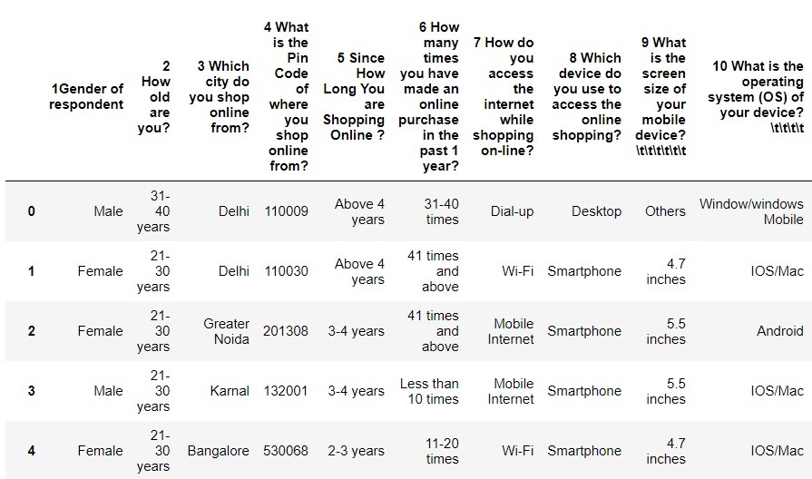
Dataset As the dataset contains 269 rows and 71 columns, so taking a little part of that

Slide 4
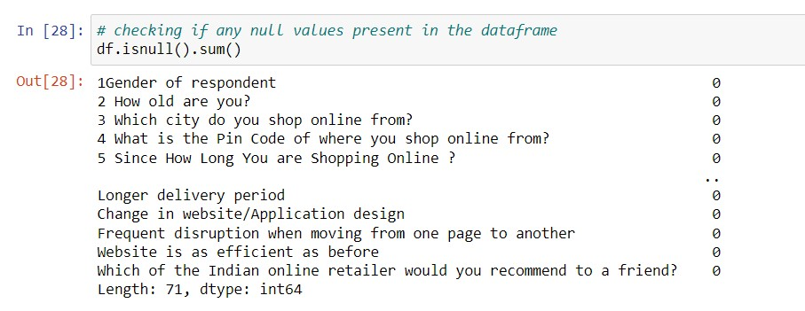
Checking for the missing values
There is not any missing or null value.

Slide 5
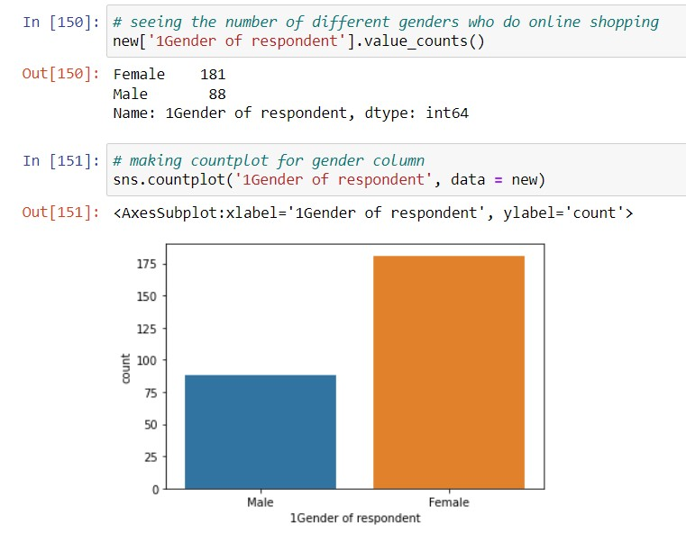
Which gender do more online shopping
Females prefer online shopping most

Slide 6
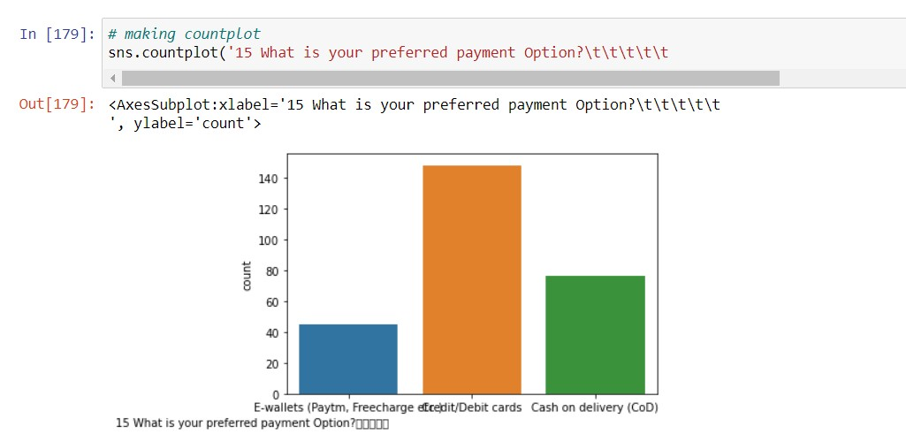
Preferred payment option by people
Credit/Debit cards are most preferred payment option and after that Cash on delivery preferred mostly.

Slide 7
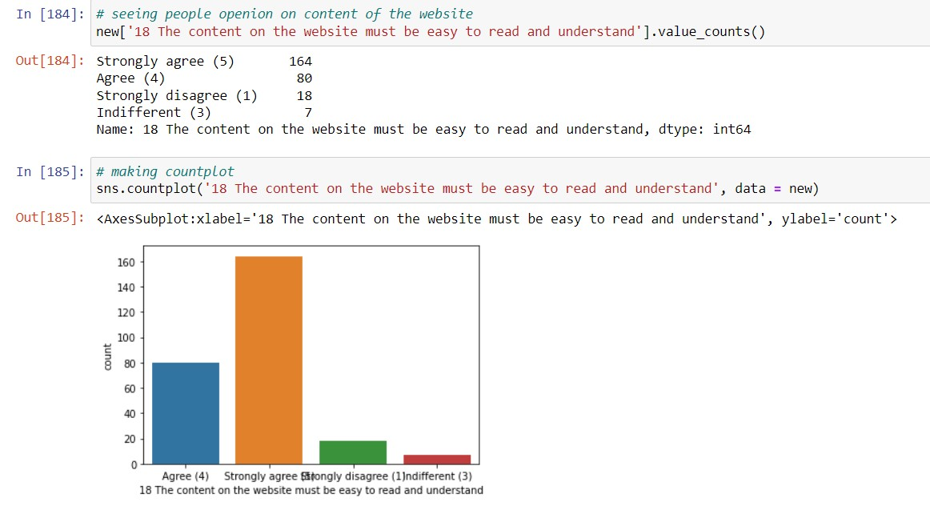
People opinion about ease of website contents
The website must be easy to read and understand it gives ease to access the website.

Slide 8
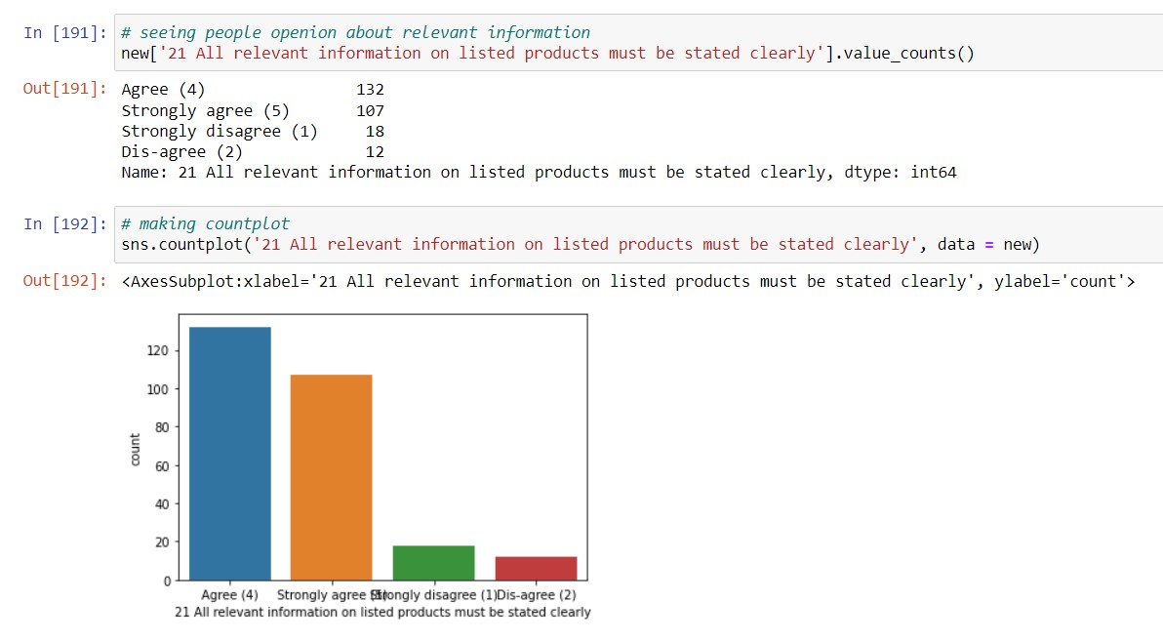
Opinion about relevant information of product
All the relevant information about the product should be stated clearly.

Slide 9
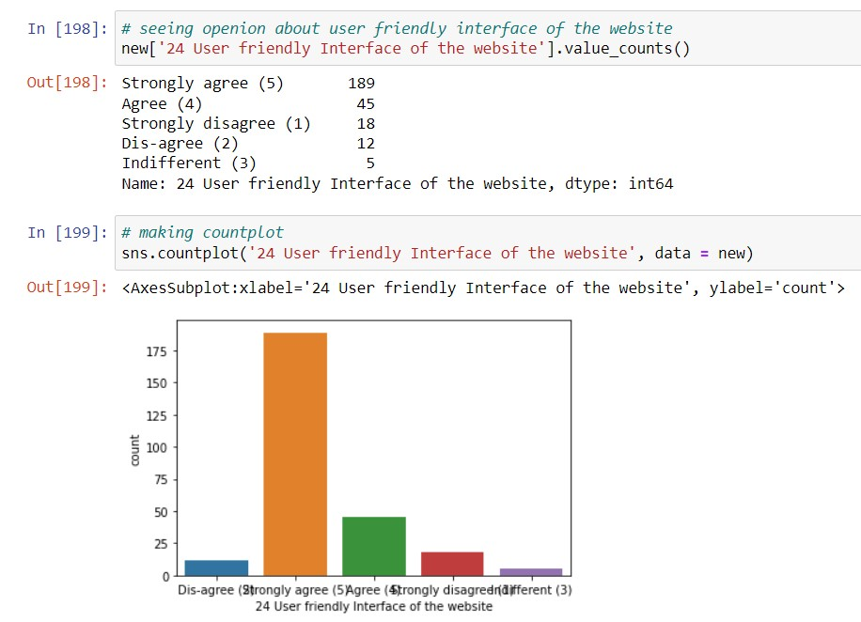
The user interface
The interface should be user friendly.

Slide 10
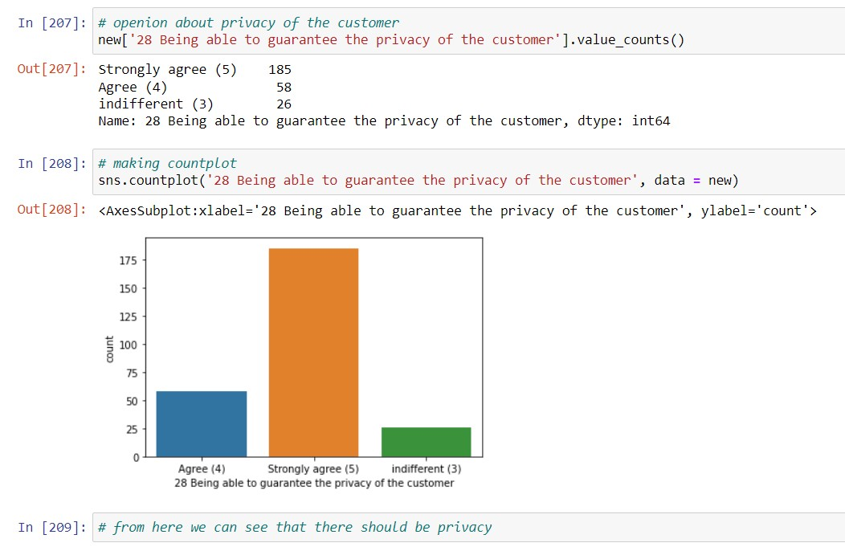
The privacy of customers
The website must guarantee the privacy of the customer.

Slide 11
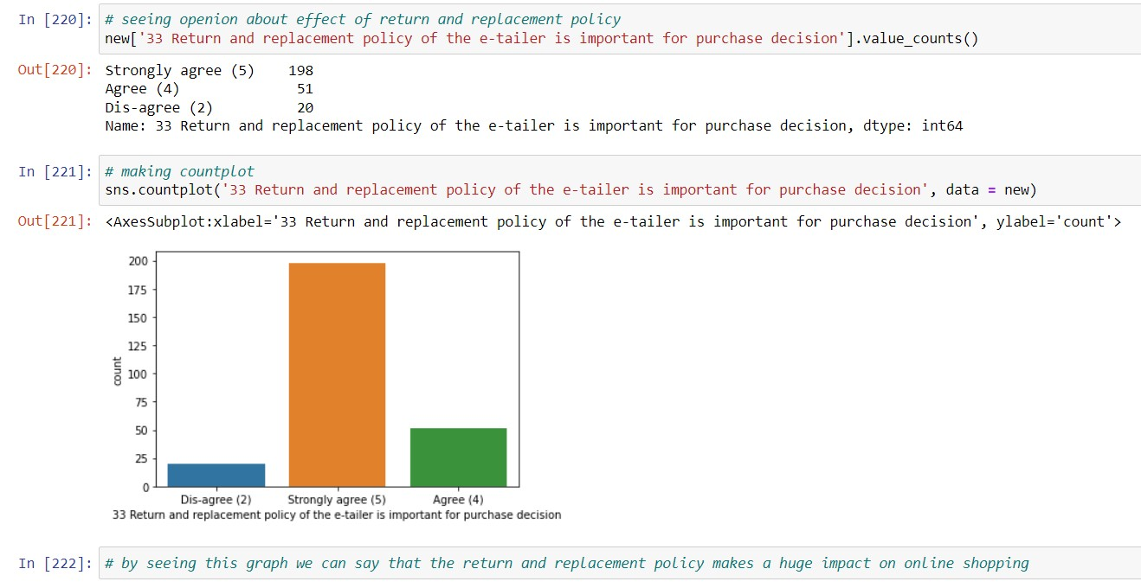
Effect of return and replacement policy
The ease of return or replacement on products plays an important role to make purchase decision.

Slide 12
Conclusion:
From the analysis we can see that there are some factors which plays important role to make decision to do online
shopping. Some of these factors are following:
The customer information should be private.
The interface of the website should be easy and user friendly.
All the relevant information of the product should be available.
There should be multiple payment options available on the products.
The return and replacement policy should be easy and hassle free.

Slide 13
Thank You

